Slide 1
Analysis of Employee Dataset Using SQL
By,
YASHASWINI T G

Slide 2
Content
Objective: This presentation showcases an analysis of the employee dataset, which includes various attributes such as employee ID, name, job role, manager ID, hire date, salary, commission, and department ID.
Dataset Overview: The dataset consists of 14 employees with diverse roles ranging from management to clerical positions.
Key metrics analyzed include salary distributions, commission structures, and hierarchical relationships within the organization.

Slide 3
Types of Queries Utilized
Data Retrieval Queries:Retrieve complete information about employees.
Find unique job titles and departments.
List employees based on specific criteria (e.g., salary range).
Aggregation Queries:Calculate average salaries for specific job roles.
Count the number of employees in each department or job title.
Sum total commissions or salaries for analysis.
Filtering Queries:Identify employees based on hire dates.
Filter employees who do not belong to specific departments.
Find employees with specific job titles or salary conditions.
Join Queries:Combine employee data with department details to provide comprehensive insights.
Identify relationships between employees and their managers.
Conditional Queries:Find employees whose commissions exceed their salaries.
Identify those who meet specific criteria related to salary increases or job roles.
Subqueries:Use subqueries to filter data based on aggregated results (e.g., average salary comparisons).

Slide 4
Table Structure employees
emp_id: Unique identifier for each employee (Primary Key).
emp_name: Name of the employee.
job_name: Job title of the employee.
manager_id: ID of the employee's manager (can be NULL for top-level positions).
hire_date: Date when the employee was hired.
salary: Employee's salary.
commission: Commission earned by sales personnel (can be NULL for non-sales roles).
dep_id: Department ID to which the employee belongs.

Slide 5
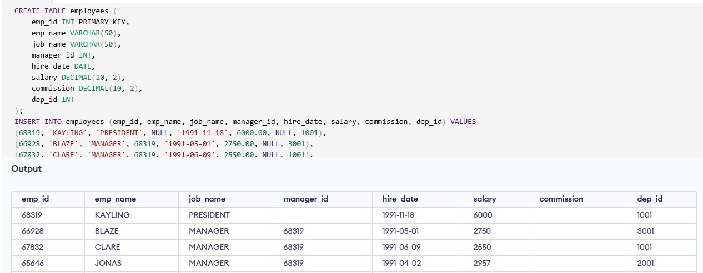
To create a SQL table based on the provided employee data and insert the records into that table

Slide 6
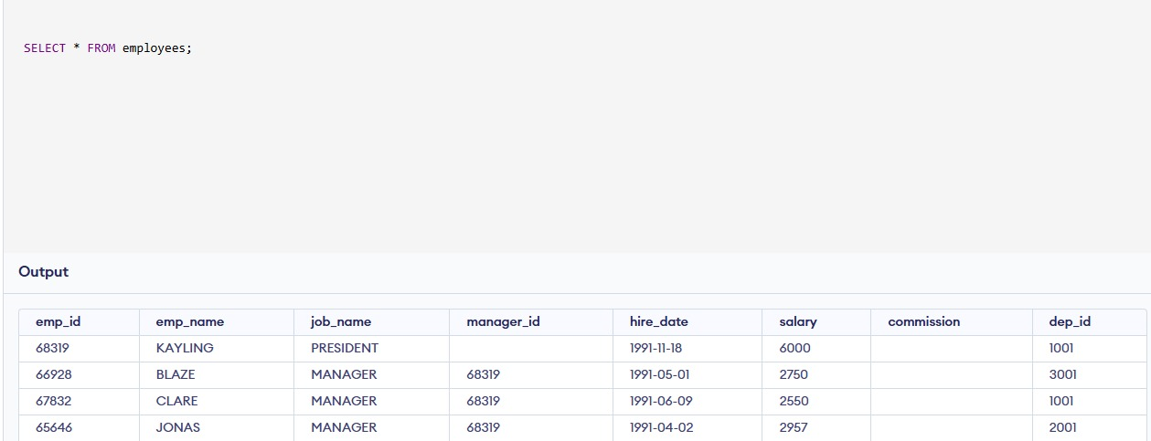
From the following table return complete information about the employees.

Slide 7
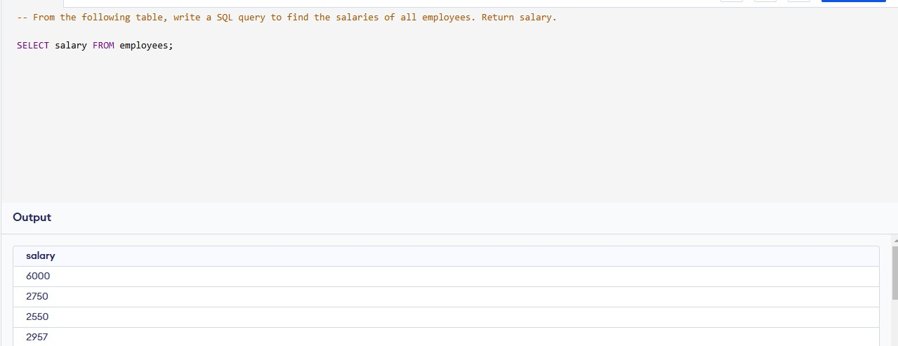
From the table, write a SQL query to find the salaries of all the employees

Slide 8
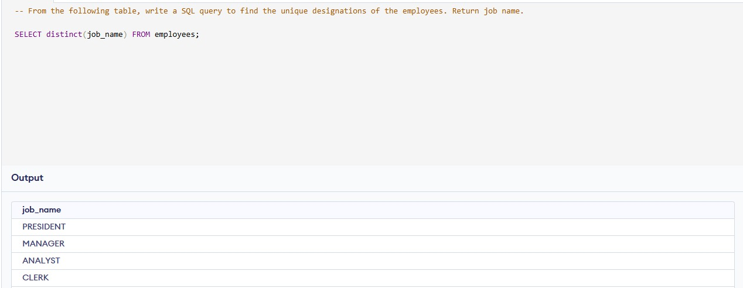
From the following table, write a SQL query to find the unique designations of the employees. Return job name.

Slide 9
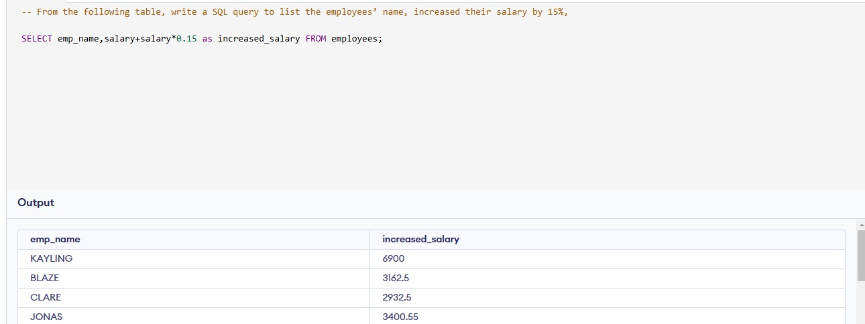
From the following table, write a SQL query to list the employees’ name, increased their salary by 15%, and expressed as number of Dollars.

Slide 10
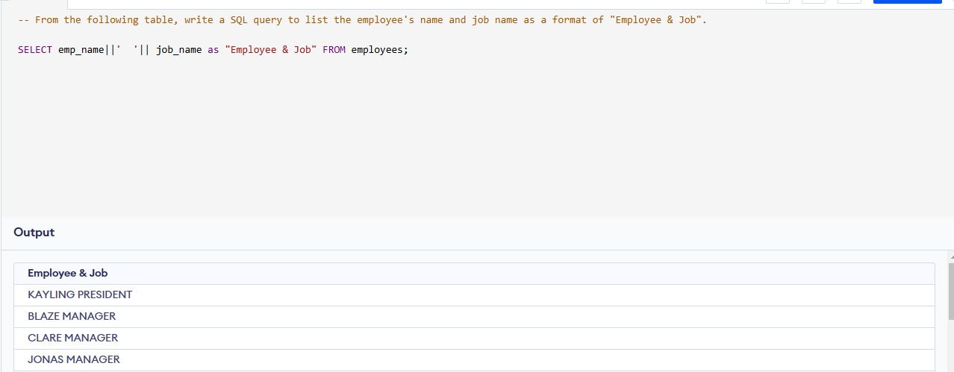
From the following table, write a SQL query to list the employee's name and job name as a format of "Employee & Job".

Slide 11
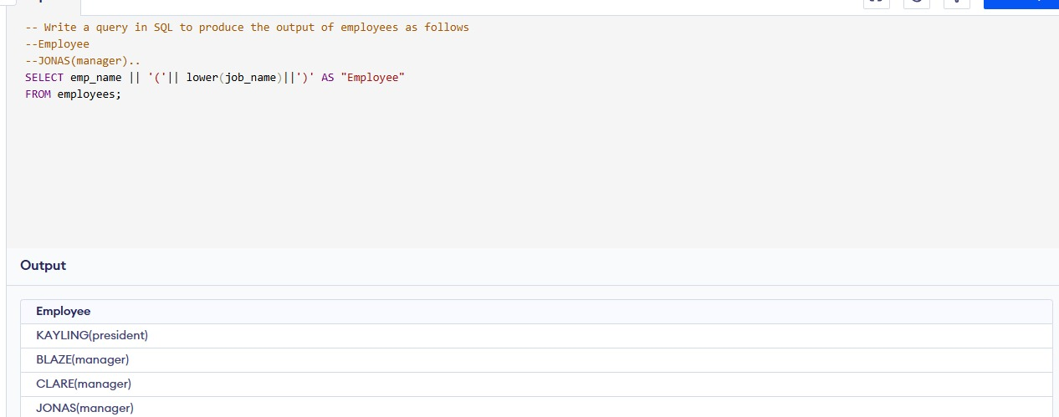
Write a query in SQL to produce the output of employees as follows.EmployeeJONAS(manager).

Slide 12
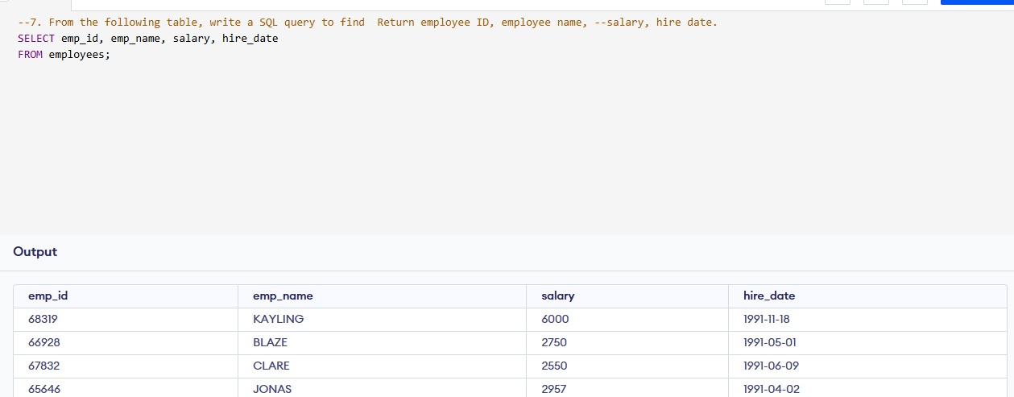
From the following table, write a SQL query to find employee ID, employee name, salary, hire date.

Slide 13
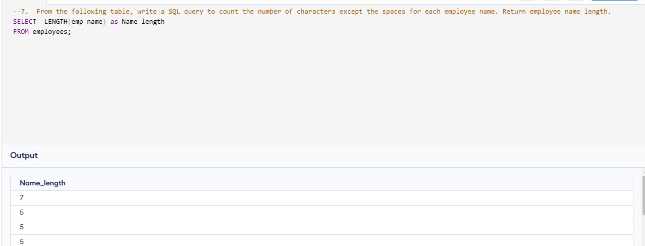
From the following table, write a SQL query to count the number of characters except the spaces for each employee name. Return employee name length.

Slide 14
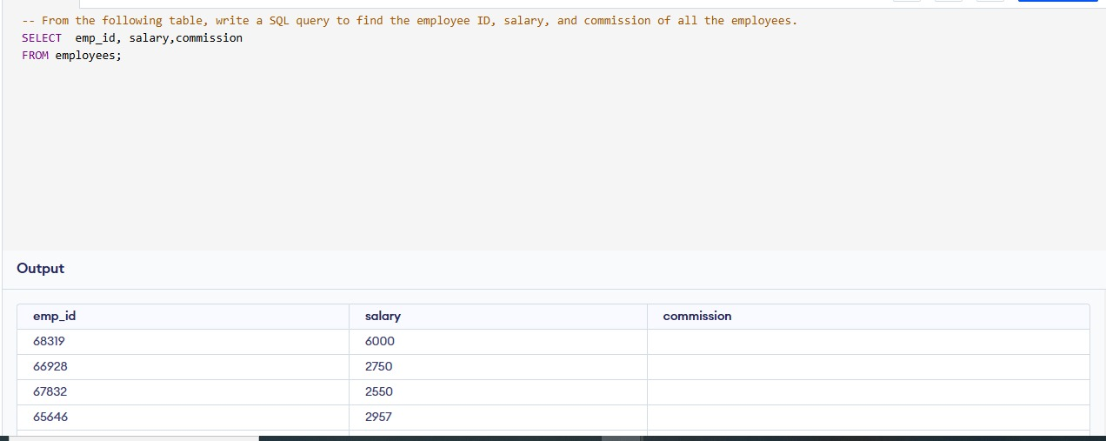
From the following table, write a SQL query to find the employee ID, salary, and commission of all the employees.

Slide 15
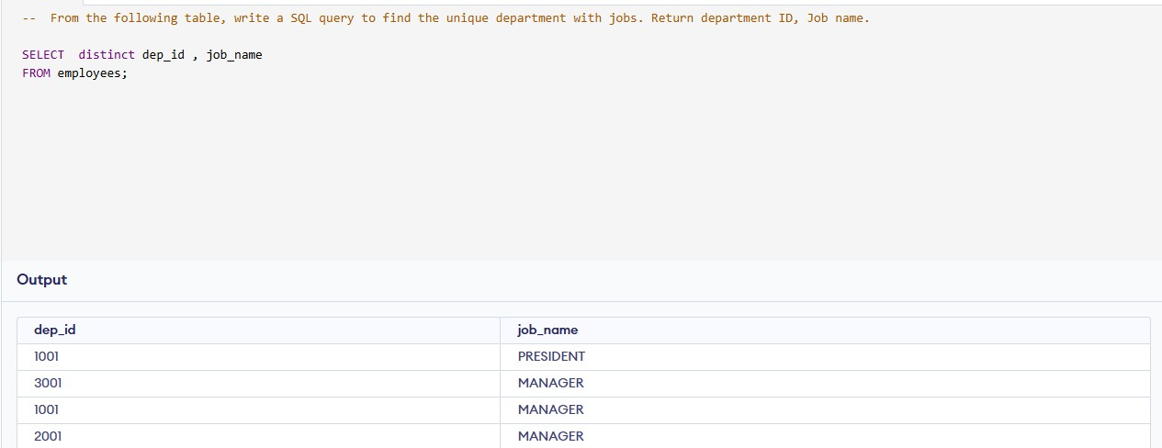
From the following table, write a SQL query to find the unique department with jobs. Return department ID, Job name.

Slide 16
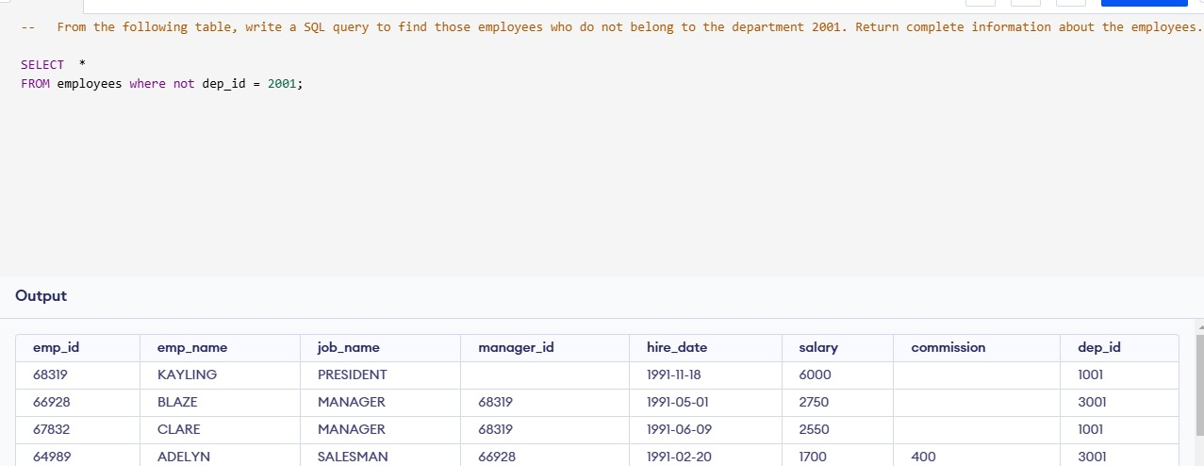
From the following table, write a SQL query to find those employees who do not belong to the department 2001. Return complete information about the employees.

Slide 17
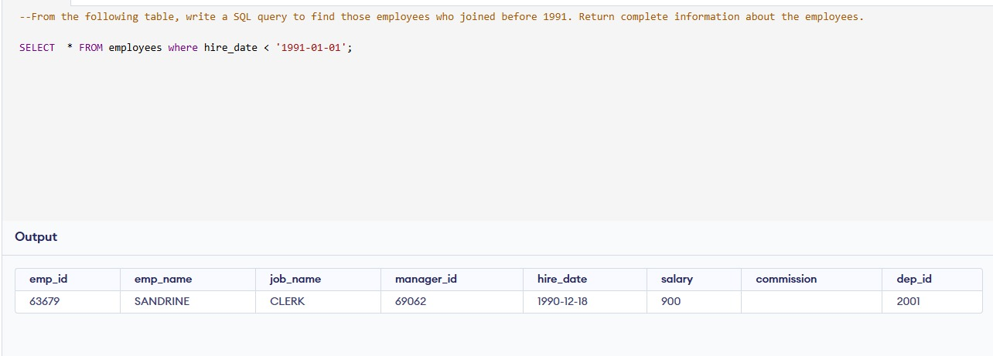
From the following table, write a SQL query to find those employees who joined before 1991. Return complete information about the employees.

Slide 18
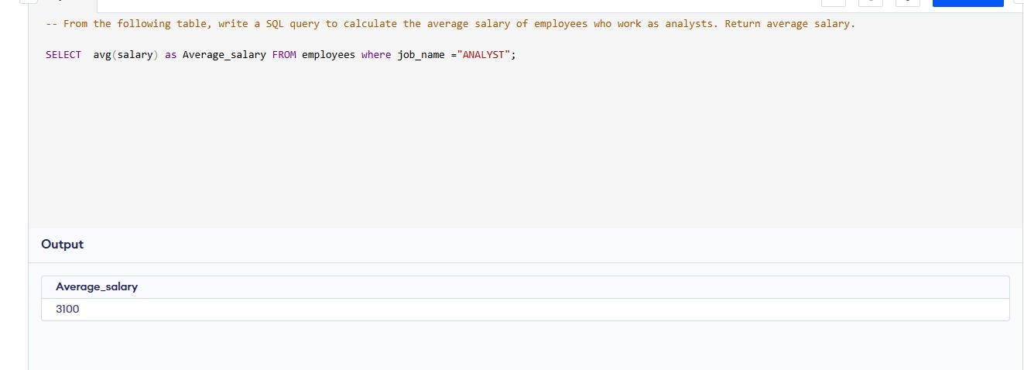
From the following table, write a SQL query to calculate the average salary of employees who work as analysts. Return average salary.

Slide 19
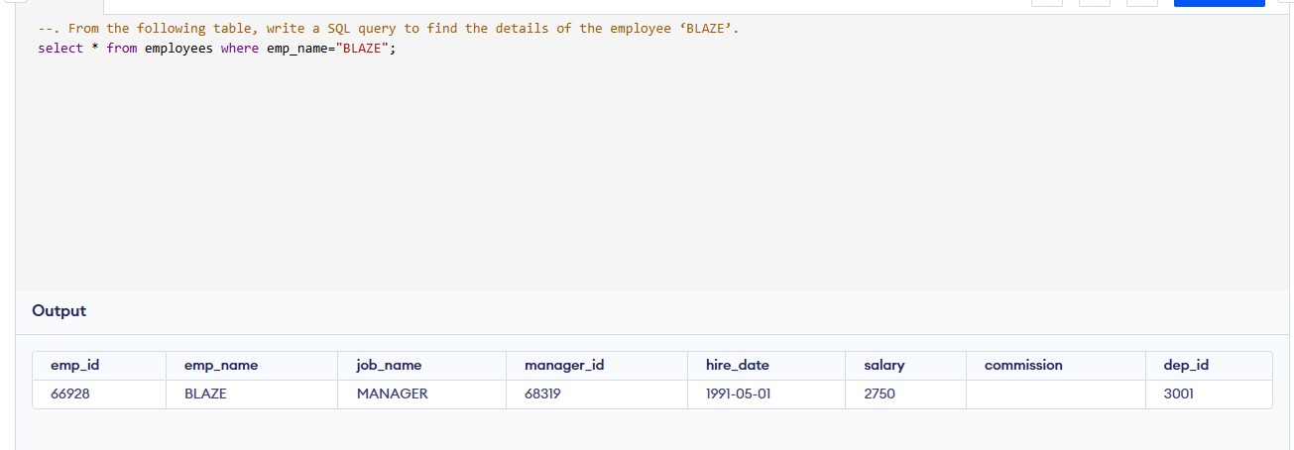
From the following table, write a SQL query to find the details of the employee ‘BLAZE’.

Slide 20
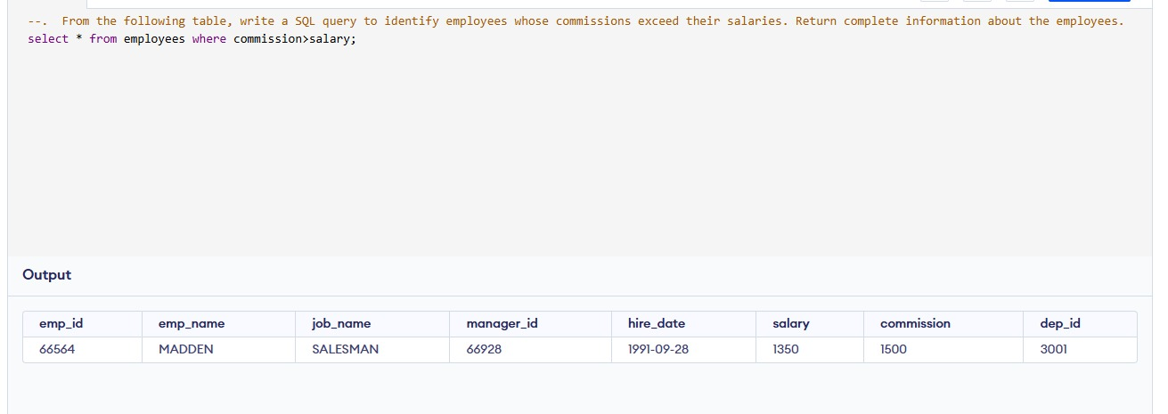
From the following table, write a SQL query to identify employees whose commissions exceed their salaries. Return complete information about the employees.

Slide 21
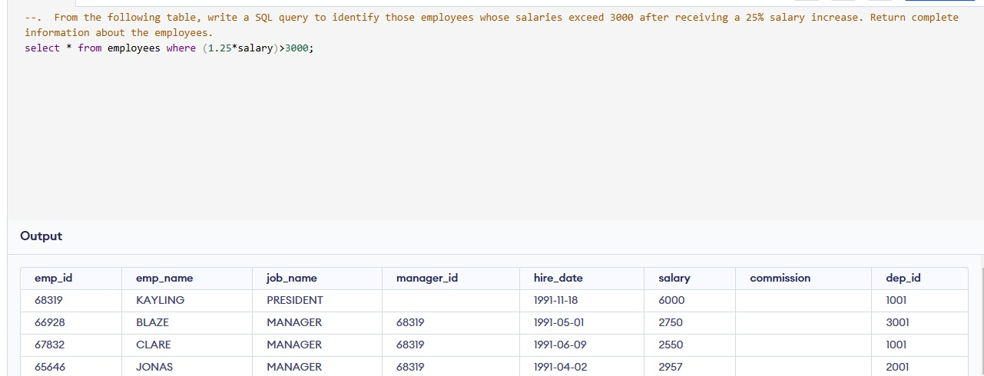
From the following table, write a SQL query to identify those employees whose salaries exceed 3000 after receiving a 25% salary increase. Return complete information about the employees.

Slide 22
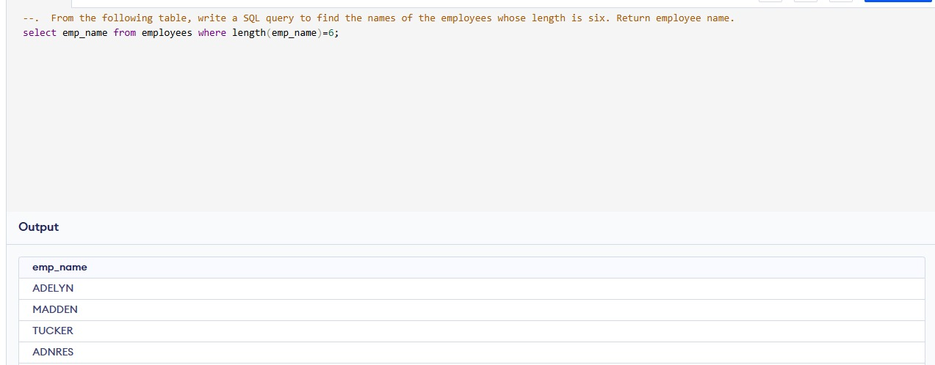
From the following table, write a SQL query to find the names of the employees whose length is six. Return employee name.

Slide 23
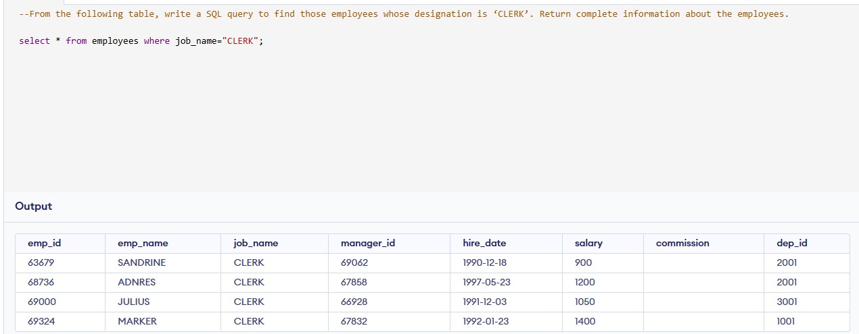
From the following table, write a SQL query to find those employees whose designation is ‘CLERK’. Return complete information about the employees.

Slide 24
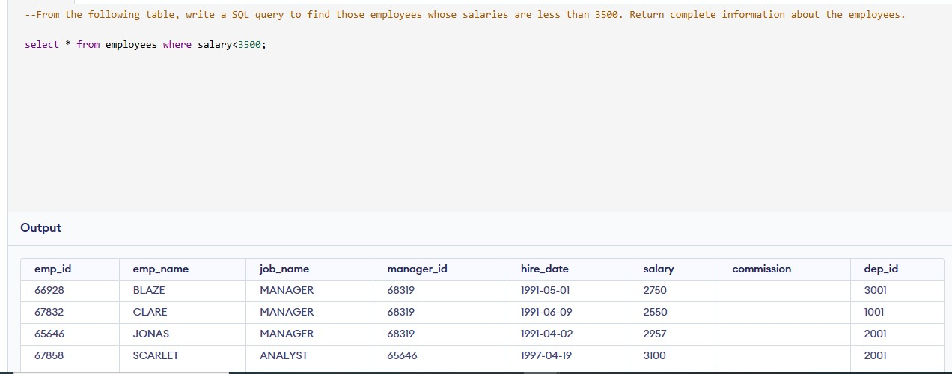
From the following table, write a SQL query to find those employees whose salaries are less than 3500. Return complete information about the employees.

Slide 25
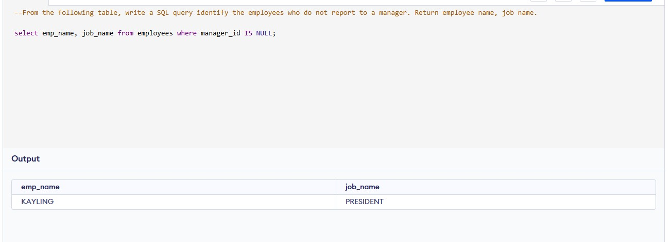
From the following table, write a SQL query identify the employees who do not report to a manager. Return employee name, job name.

Slide 26
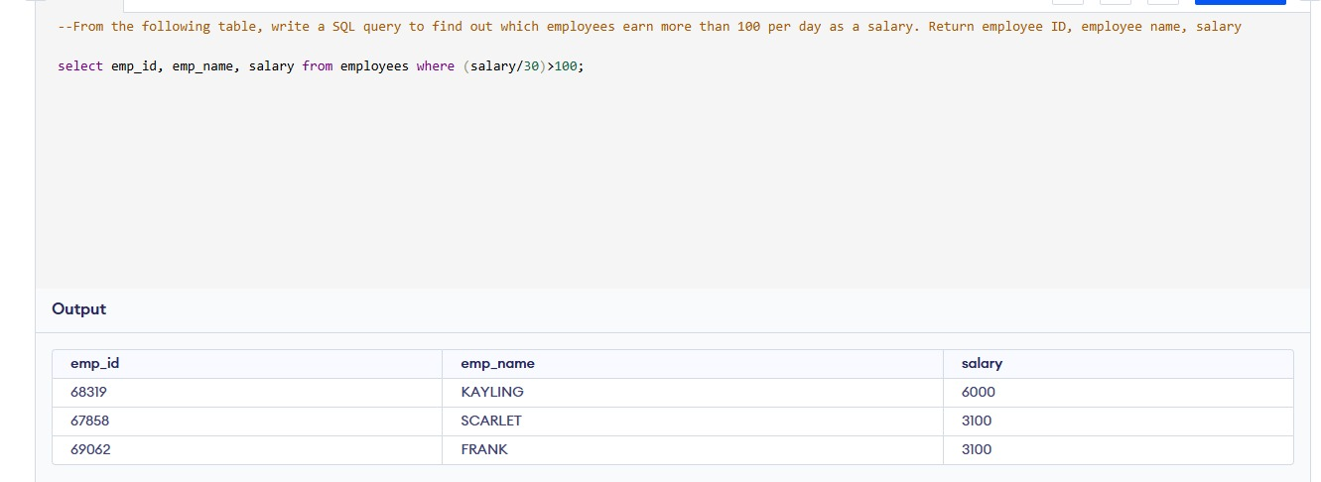
From the following table, write a SQL query to find out which employees earn more than 100 per day as a salary. Return employee ID, employee name, salary, and experience.

Slide 27
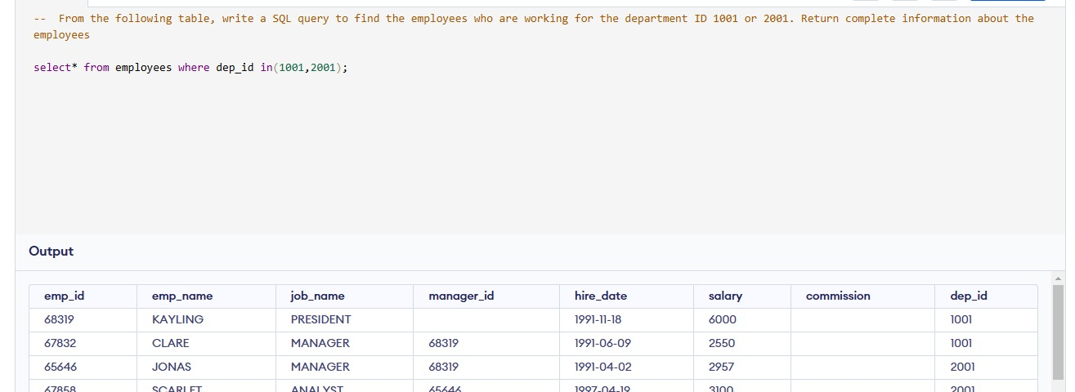
From the following table, write a SQL query to find the employees who are working for the department ID 1001 or 2001. Return complete information about the employees

Slide 28
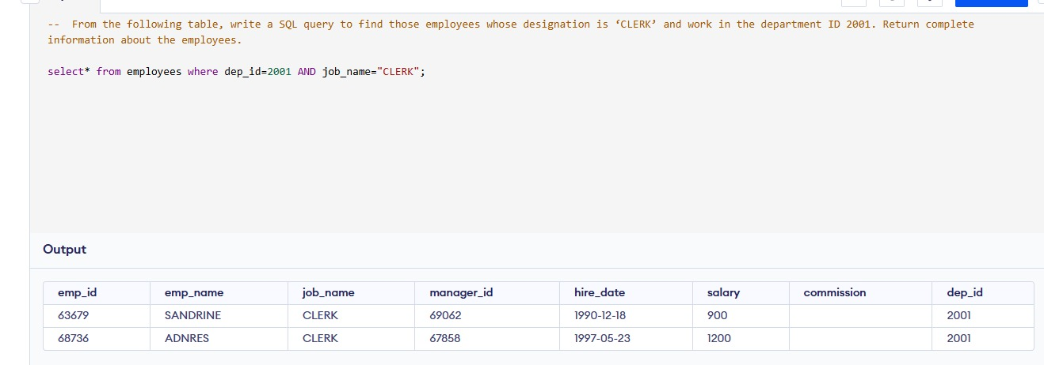
From the following table, write a SQL query to find those employees whose designation is ‘CLERK’ and work in the department ID 2001. Return complete information about the employees.

Slide 29
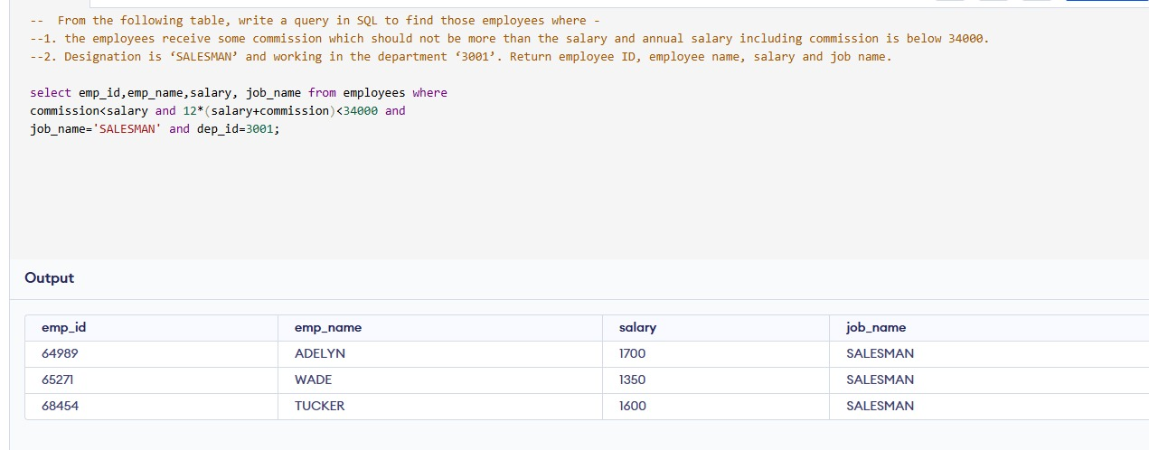
From the following table, write a query in SQL to find those employees where -1. the employees receive some commission which should not be more than the salary and annual salary including commission is below 34000.2. Designation is ‘SALESMAN’ and working in the department ‘3001’. Return employee ID, employee name, salary and job name.

Slide 30
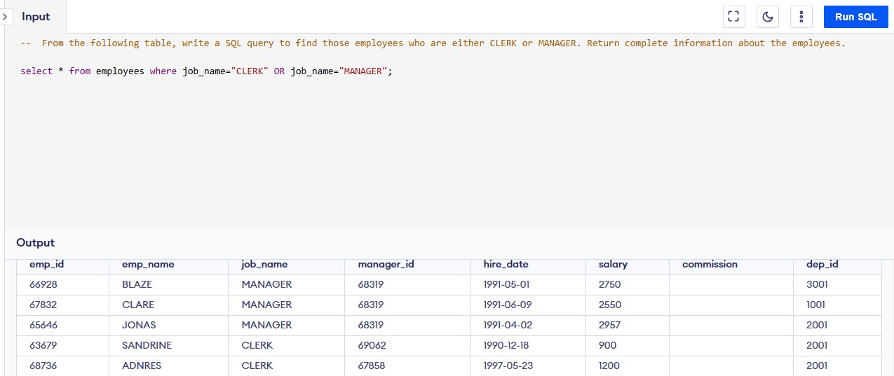
From the following table, write a SQL query to find those employees who are either CLERK or MANAGER. Return complete information about the employees.

Slide 31
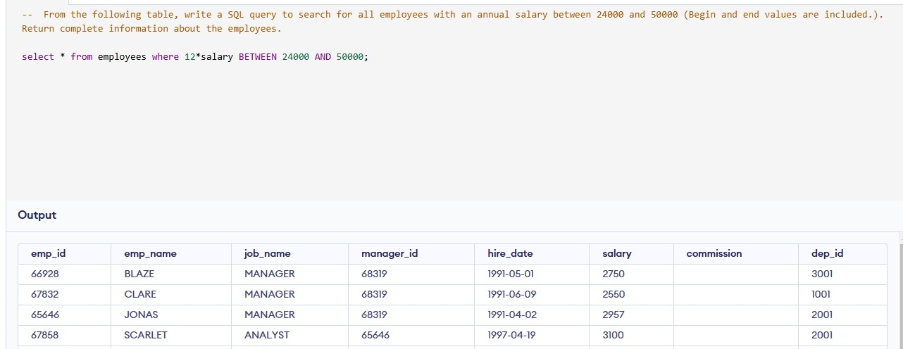
From the following table, write a SQL query to search for all employees with an annual salary between 24000 and 50000 (Begin and end values are included.). Return complete information about the employees

Slide 32
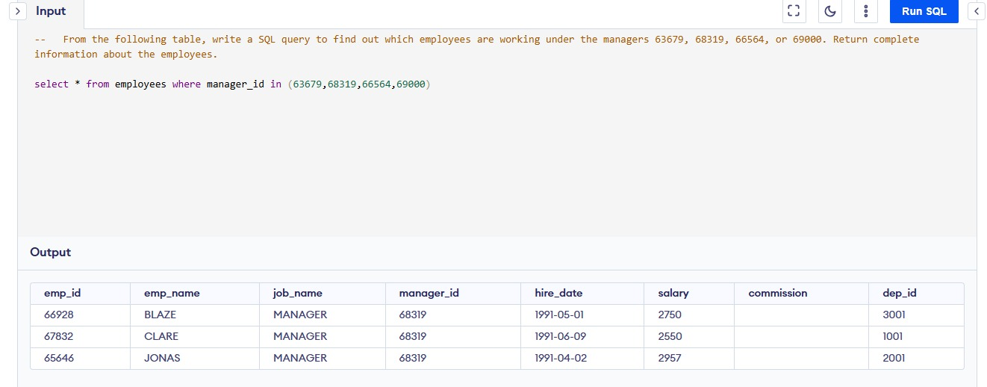
From the following table, write a SQL query to find out which employees are working under the managers 63679, 68319, 66564, or 69000. Return complete information about the employees.

Slide 33
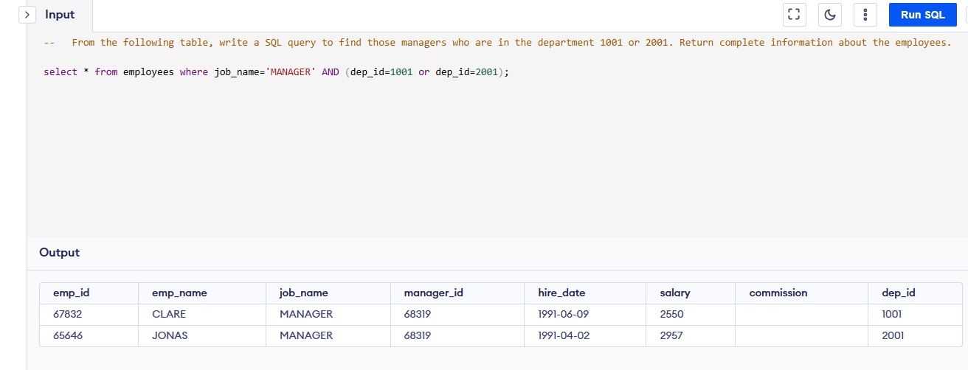
From the following table, write a SQL query to find those managers who are in the department 1001 or 2001. Return complete information about the employees.

Slide 34
Table Structure Department
dep_id: Unique identifier for each department (Primary Key).
dep_name: Name of the department.
dep_location: Location of the department.

Slide 35
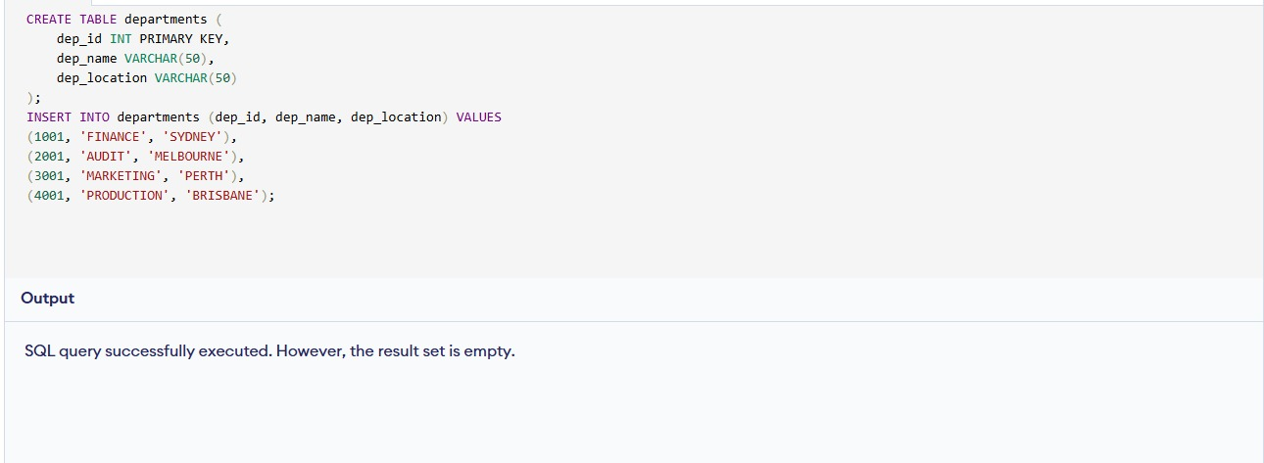
Create table department

Slide 36
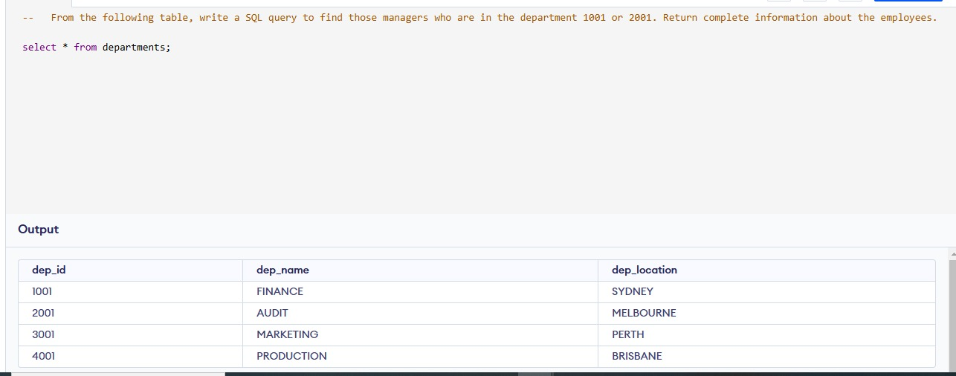
From the following table return complete information about the departments.

Slide 37
Table Structure salary_grade
grade: Unique identifier for each salary grade (Primary Key).
min_sal: Minimum salary for the corresponding grade.
max_sal: Maximum salary for the corresponding grade.

Slide 38
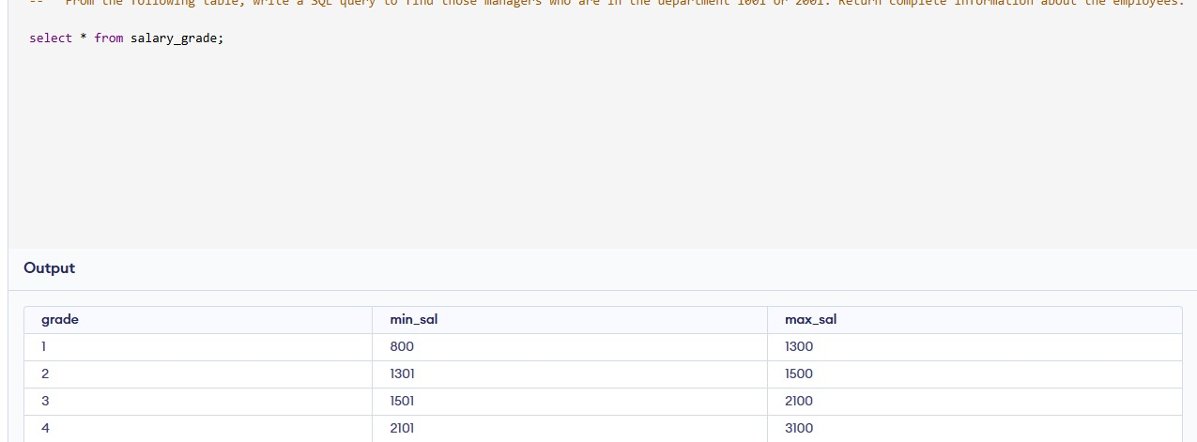
From the following table return complete information about the salary grade.

Slide 39
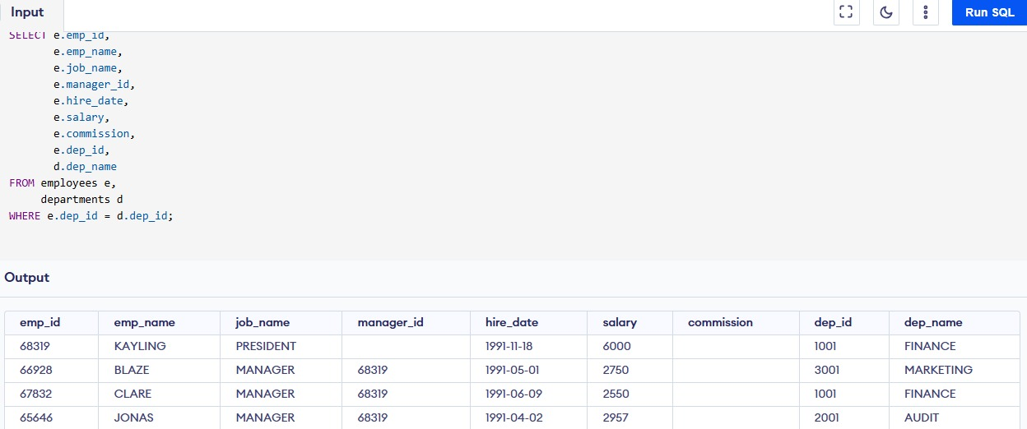
From the following table, write a SQL query to find employees along with their department details. Return employee ID, employee name, job name, manager ID, hire date, salary, commission, department ID, and department name.

Slide 40
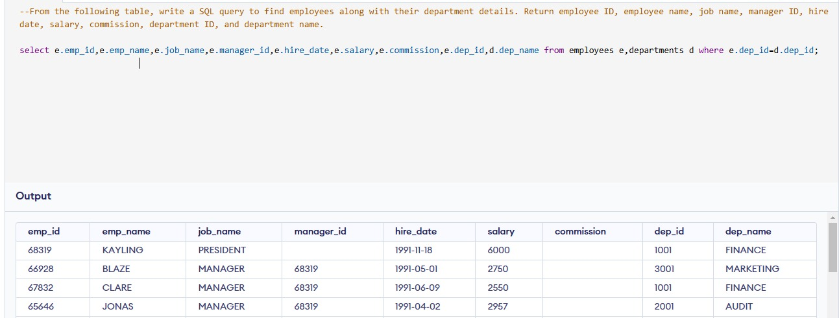
From the following table, write a SQL query to find employees along with their department details. Return employee ID, employee name, job name, manager ID, hire date, salary, commission, department ID, and department name.

Slide 41
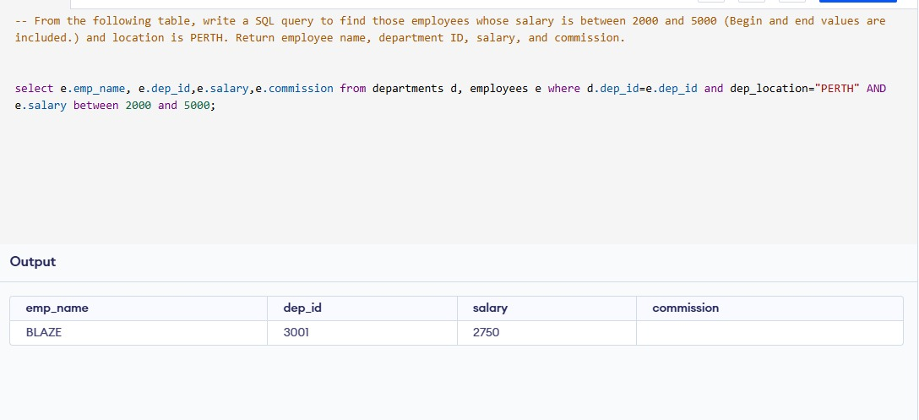
From the following table, write a SQL query to find those employees whose salary is between 2000 and 5000 (Begin and end values are included.) and location is PERTH. Return employee name, department ID, salary, and commission.

Slide 42
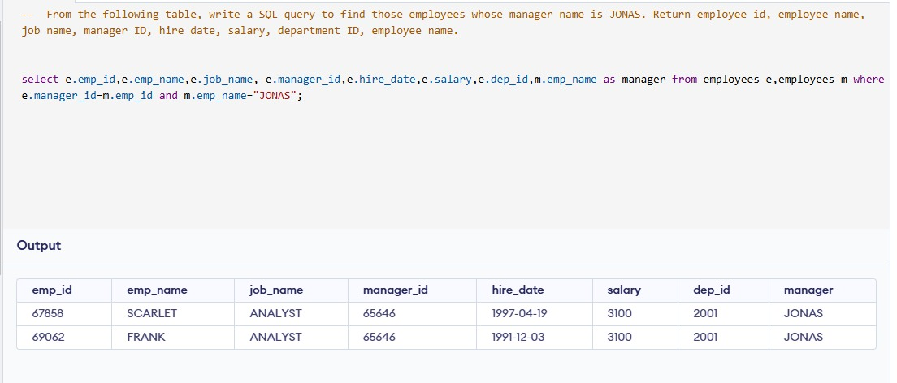
From the following table, write a SQL query to find those employees whose manager name is JONAS. Return employee id, employee name, job name, manager ID, hire date, salary, department ID, employee name.

Slide 43
Conclusion
In analyzing the employee dataset, several key insights and patterns emerged that provide a comprehensive understanding of the workforce dynamics within the organization:
Salary Distribution: The analysis highlighted variations in salaries across different job roles and departments. Employees in managerial positions generally earned higher salaries compared to clerical staff.
Commission Structures: A significant number of employees in sales roles received commissions, which contributed to their overall compensation. However, some employees had commissions exceeding their base salaries, indicating potential disparities in earnings.
Employee Demographics: The dataset allowed for filtering employees based on hire dates, job titles, and departments. This helped identify trends related to employee tenure and job roles.
Performance Indicators: Queries focused on average salaries for specific job roles (e.g., analysts) provided insights into compensation standards and potential areas for salary adjustments.
Managerial Hierarchies: The analysis of reporting structures revealed insights into the organizational hierarchy and how many employees report to specific managers.
Departmental Insights: The examination of employees by department ID provided an understanding of departmental sizes and the distribution of roles within those departments.
Employee Retention Factors: By analyzing employees who joined before a certain date or those with lower salaries, potential factors affecting employee retention could be identified.

